Slide 1

Data assessment Sub-objective 1 and 2
Heritage Zoning and Urbanisaiton

Slide 2
Research Aim
To assess the impact of heritage zoning on urbanisation
Notes:
Recap of the research aims, Question and the Research Subobjective to put the discusion in context.

Slide 3
Research questions and Subobjectives
How urban is a world heritage site?
To collect and assess the quality of spatial data for world heritage cities and properties.
To transform spatial data into workable formats.
To conduct land cover and land-use change detection in 20 years.
To determine the rate of land cover and land use change detection.
What is the impact of nomination on the world heritage urban footprint?
To assess the amount of land cover and land use type change before nomination.
To assess the amount of land cover and land use type change after nomination.
To compare the amount and rate of change in land use and landcover before and after nomination
Notes:
Two research questions:
Question 1 has 4 subobjectives
And
Question 2 which has 3 subobjectives
This presentation addresses the first two subobjective in the research question 1.
To collect and assess the quality of spatial data for world heritage cities and properties.
To transform spatial data into workable formats.
And as such the summary of the title as data assessment.

Slide 4
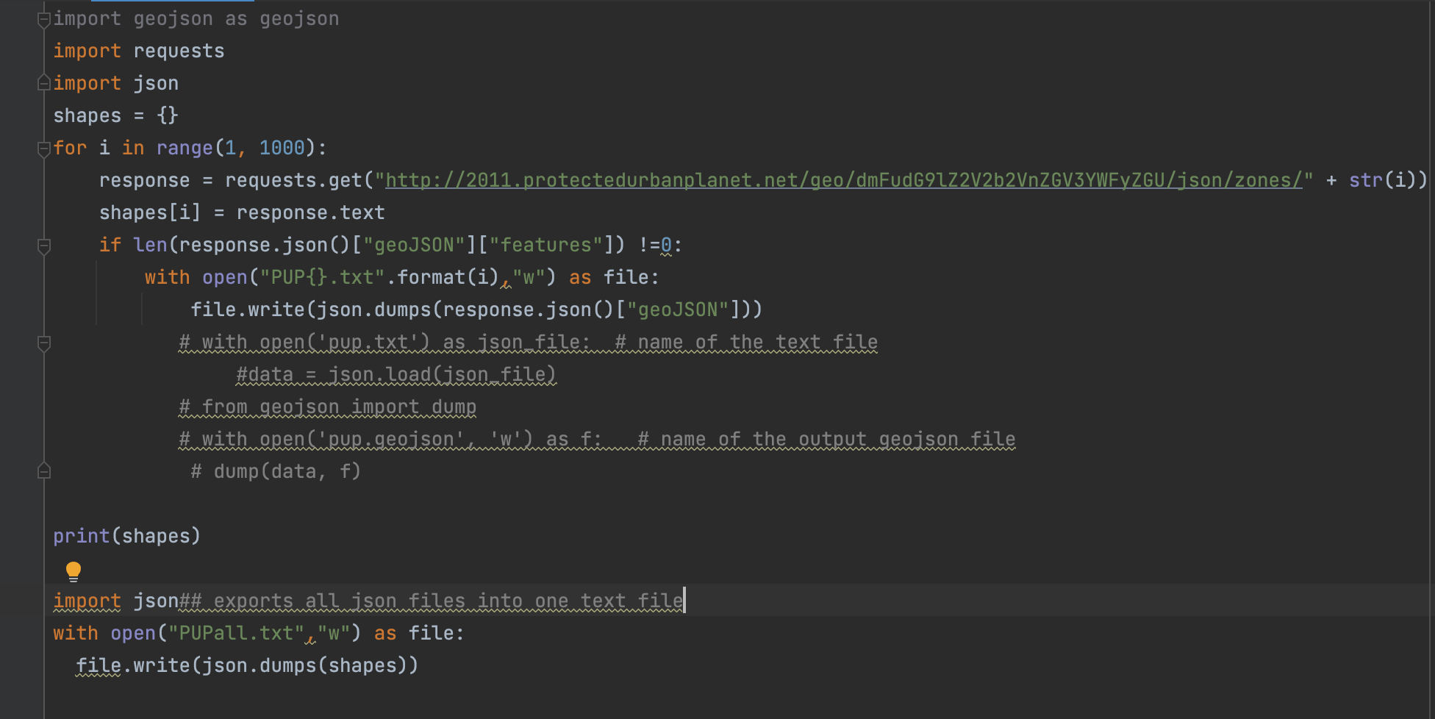
Introduction
Data collection-focus was on shape files of the core zones and the buffer zones if they existed of the world heritage properties.
Data resources included:
Protected planet-WDPA
Protected Urban planets-PUP
Data types :
Shape files(Polygons and point data of core zones)
Geojson
Data process and conversion
Dowloading data using python API request for all the shape file from protected urban planets.
Translation of Geojson files to ESR shapefiles using FME
WPDA-no translation used as downlaoded
Selected core zones using WHList
Merge data in ArcGIS
Notes:
This slide specifies the aim of the discsuion which is to give a brief introduction in the context of the resarch aim and the research question.
It basically summaries the type of data and data resources that were of interest for data collection. It mentions the resoiurces by name and the data formates and data types.

Slide 5
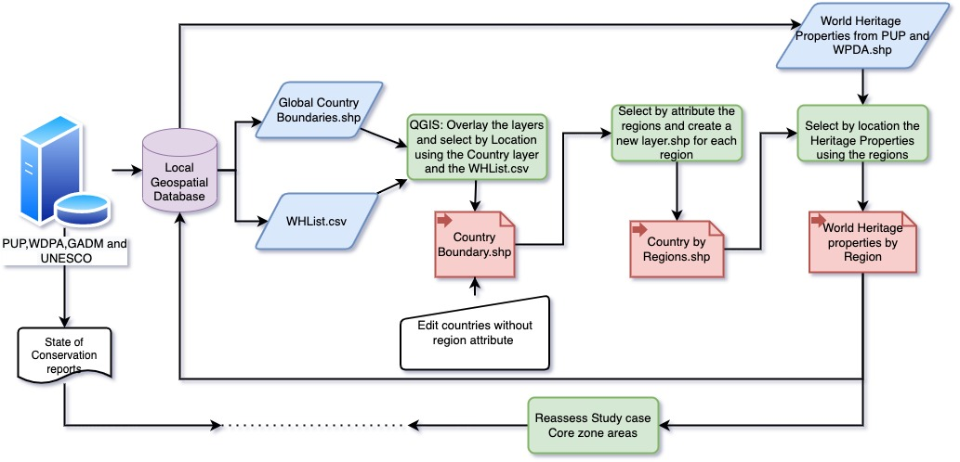
Workflow
Week 09/52 | Week 10/52 | Week 11/52 | Week 12/52
Notes:
This the slid spicifes the steps in summary that were followed. And the duration or time frame that was used up for this part of the research

Slide 6
Validation tools
For data quality assessment the from tools were used to validate the core zones:
>UNESCO PDF MAPS
>UNESCOs World Heritage List
>Open Street Map as a base layer
Notes:
This slide explains the validation or verification tools used to comparre the data collected from PUPO and WDPA with the UNESCO list, the UNESCO PDF maps and OSM.

Slide 7
Results
>Shows multiple discrepencies
>Some properties are accurate
>Examples;
Notes:
This slide summaries the findings as the next slide give the actual examples of the findings of the data assessment process.

Slide 8
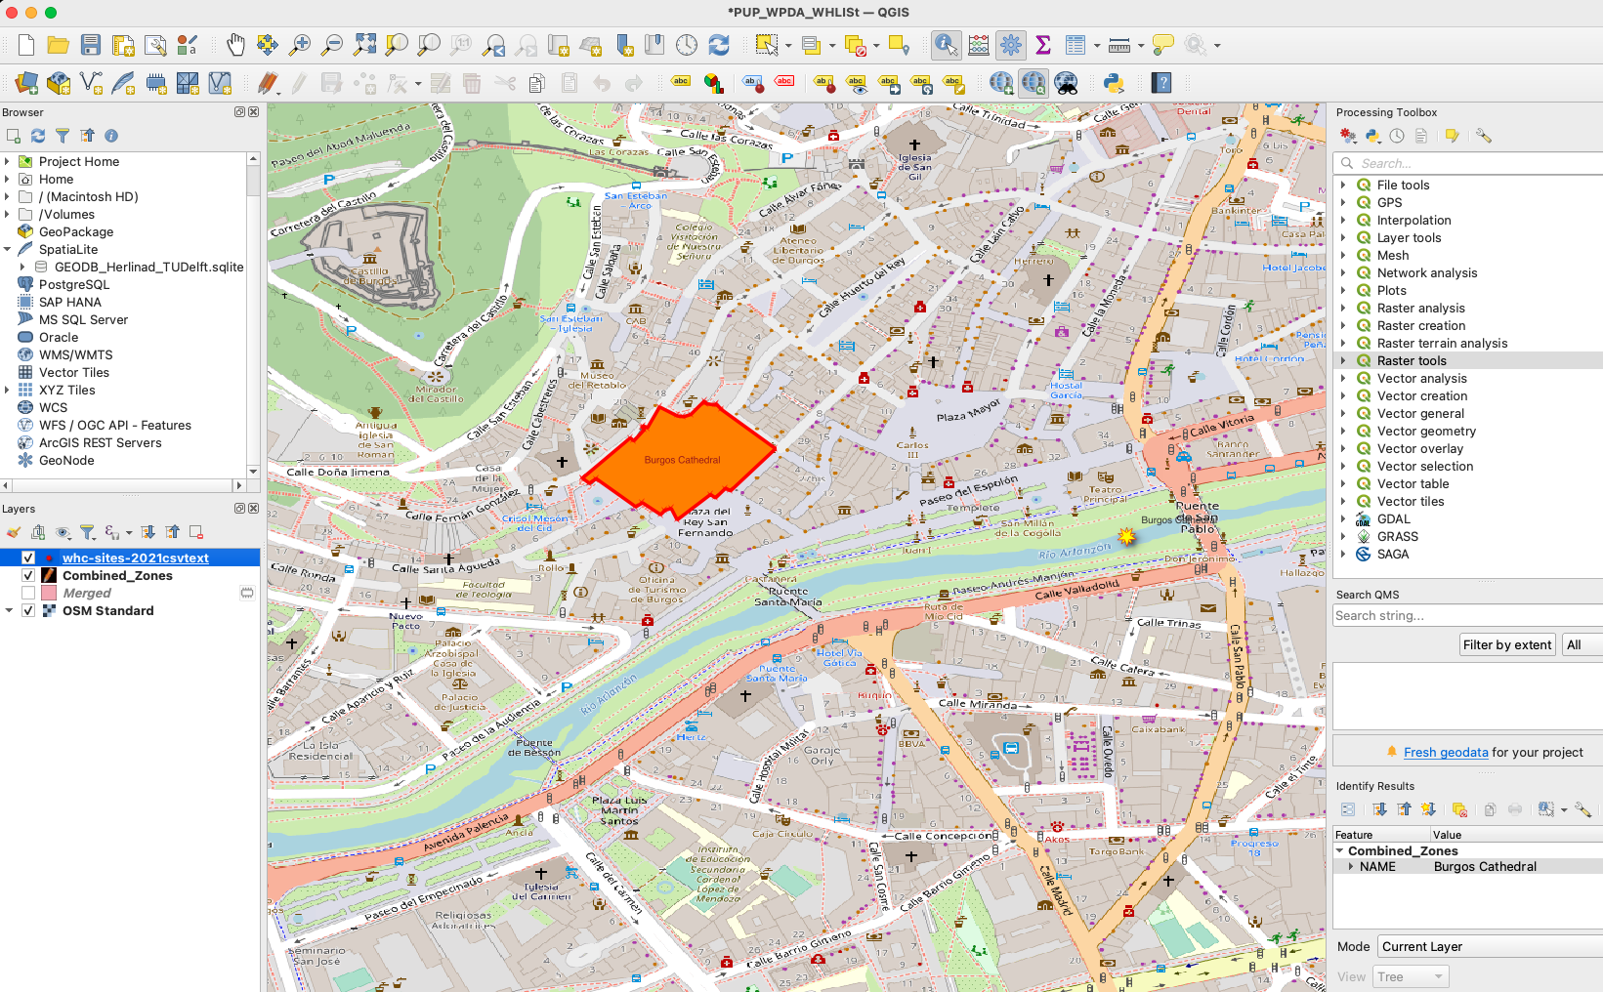
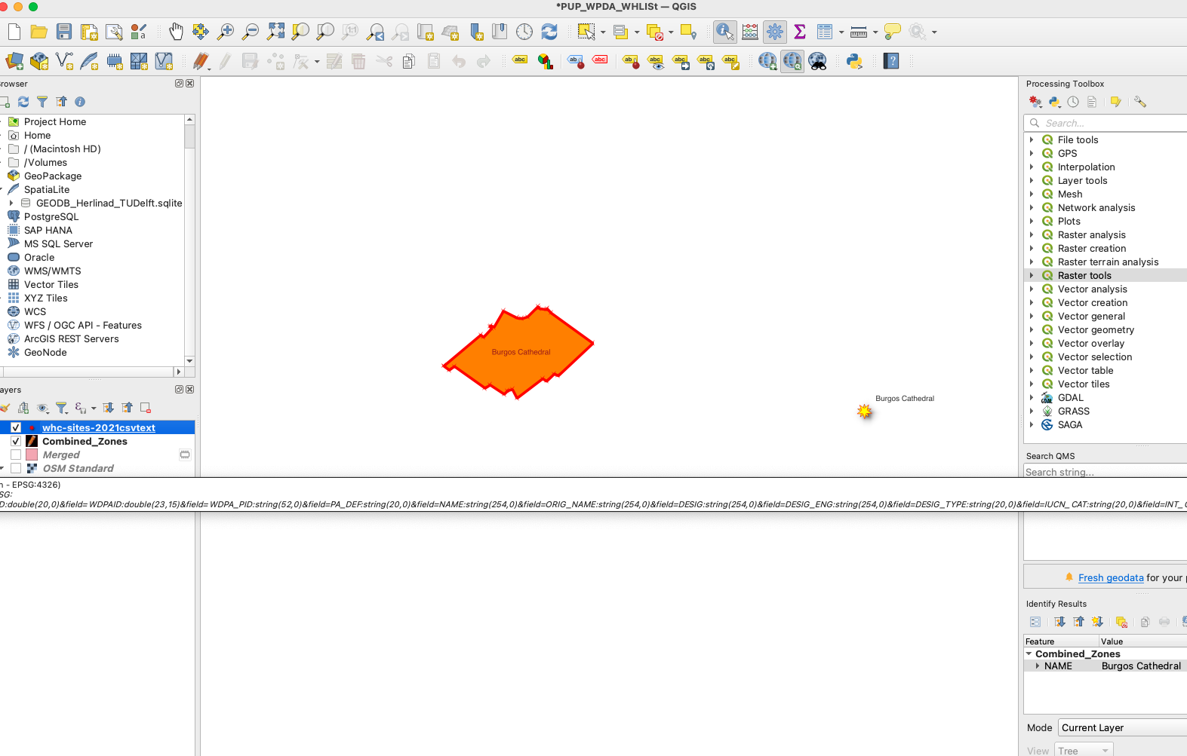
>Core zone in this case does not intersect with the Whlist point data
Exampe 1: Burgos cathedral in Spian
>Core Zone aligns with the OSM layer.
>WHList point data seems to be displaced
Notes:
Burgos Cathedral
Archaeological site of Alapuerca
Cathedral of notre Dame
Probably a projection problem

Slide 9
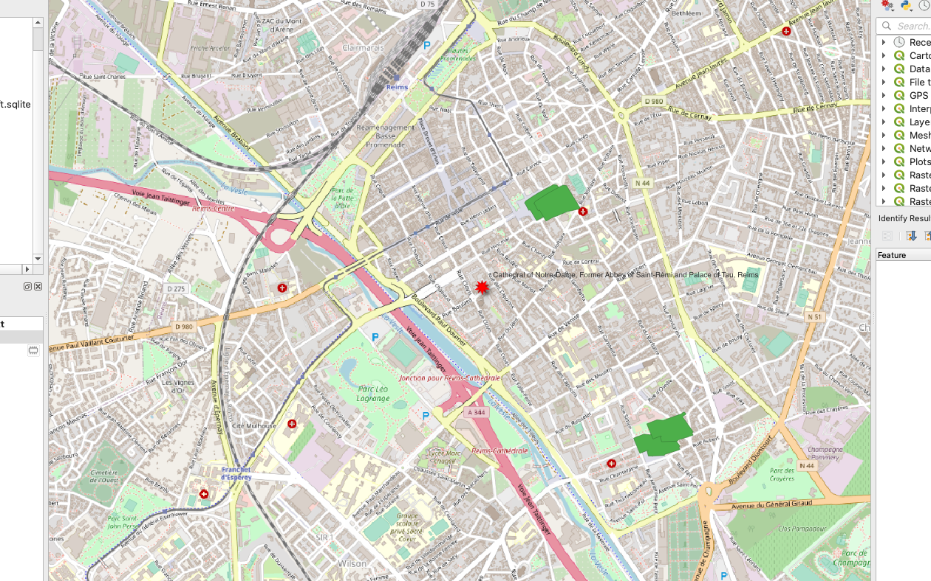
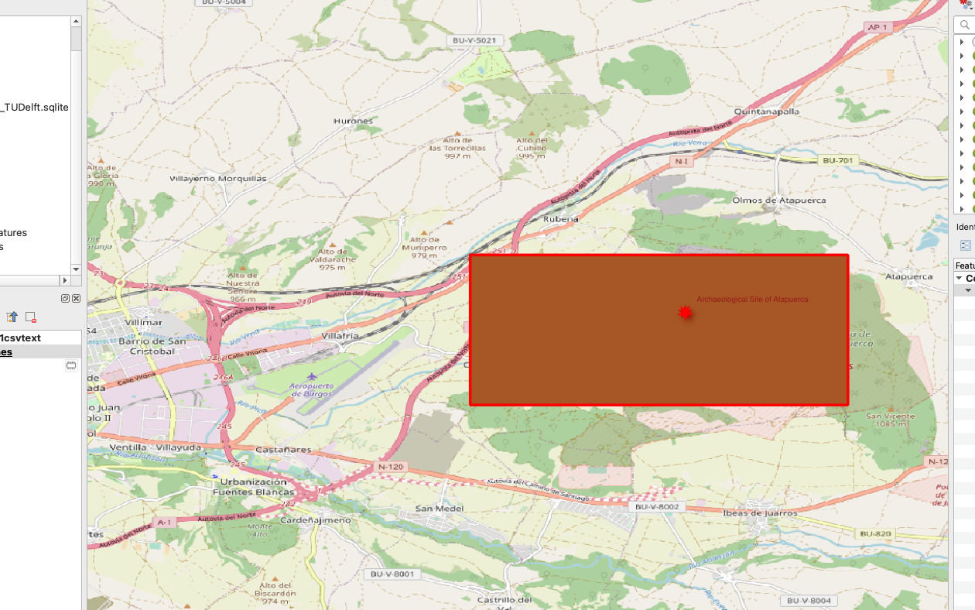
> Core zones with shapes that do not appear practical. >Accurate WHL points
Exampe 2: Archaeological site of Allapurca
>Core zones non existent
Notes:
UNIQUE core zones and Non-existent core zones.

Slide 10
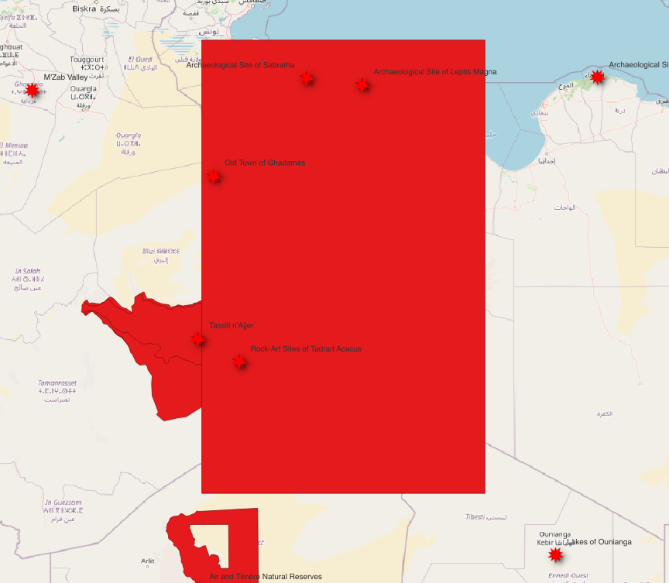
Example 3: Rock-art sites of tadrant acacus
>Unique core zone shapes
Notes:
UNIQUE core zones that may not be accurate

Slide 11
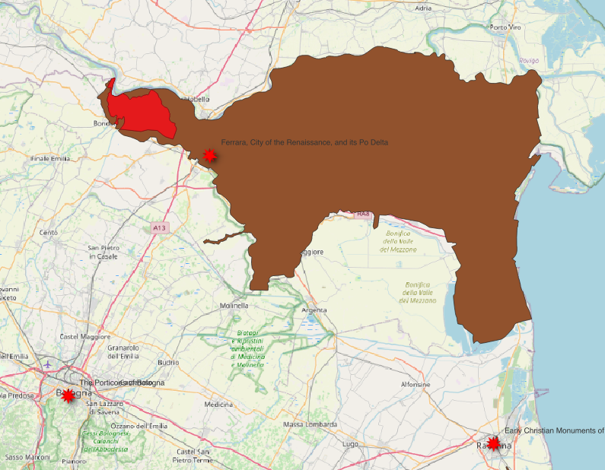
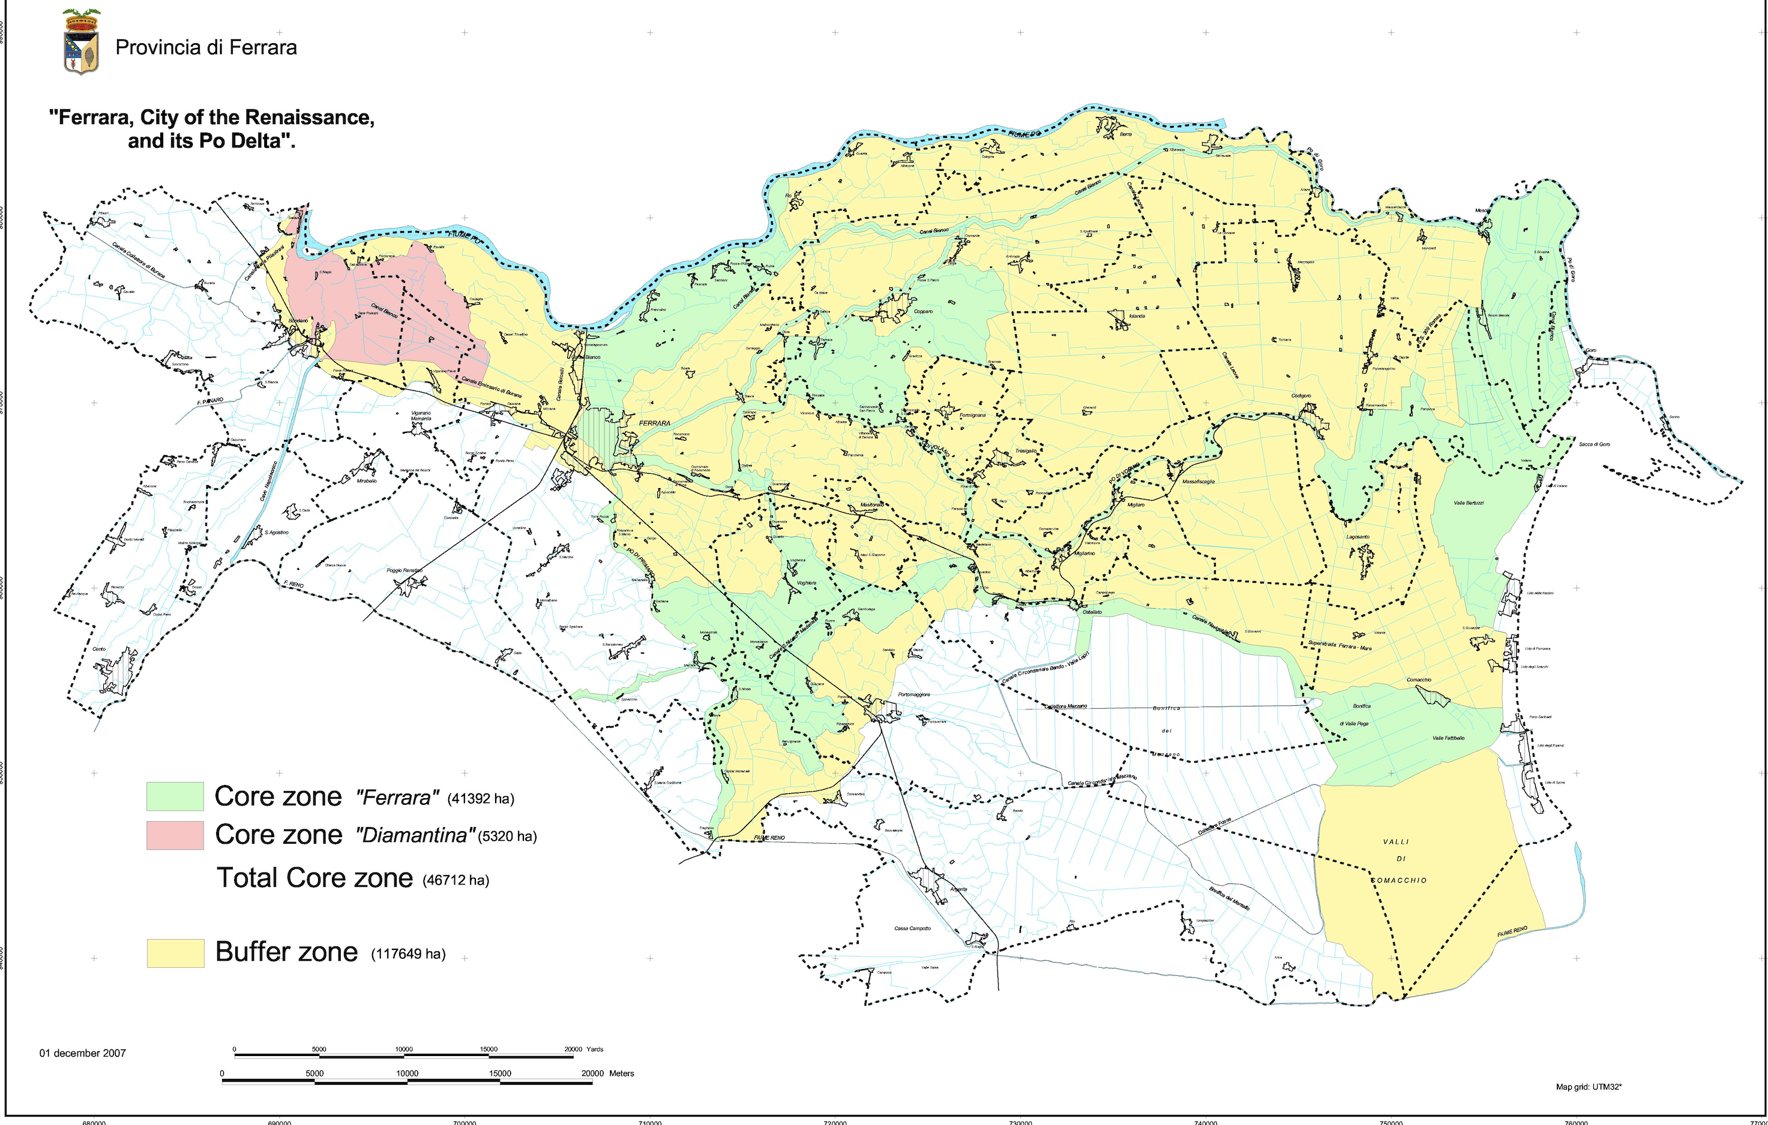
Example 4: Ferrara, city of the Renaissance and its Po Delta
> Shape file shows the buffer with one core in red commpared to the actual which has two core zones and a buffer.
Notes:
In this case we see that the original map is different from the dowloaded shape files from PUP.
It leaves out other Zones but highlights the buffer zone

Slide 12
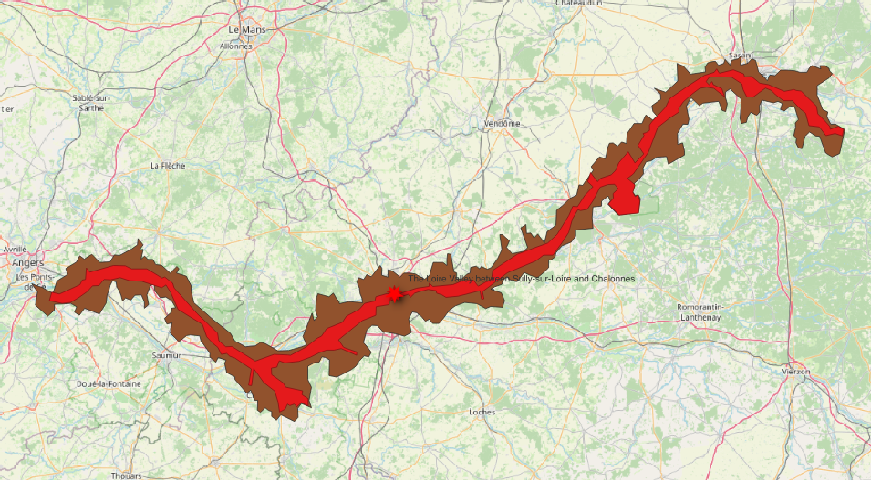
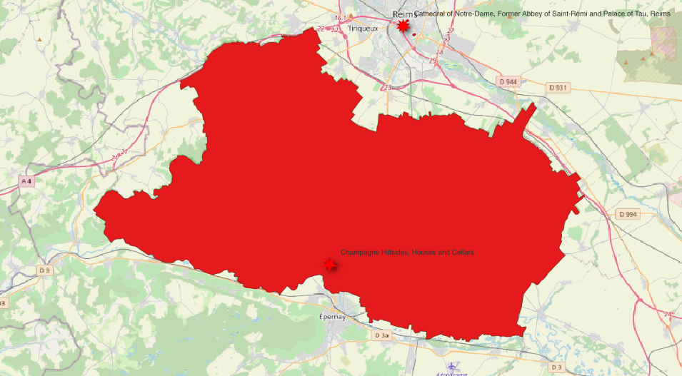
Example 5: Loire Valley & Champagne hillsides
> In this case the core zone, No buffer and the Whlist Point data is accurate
> In this case the core zone, buffer and the Whlist point data is accurate
Notes:
Here seems the OSM, WHL seem accurate.

Slide 13
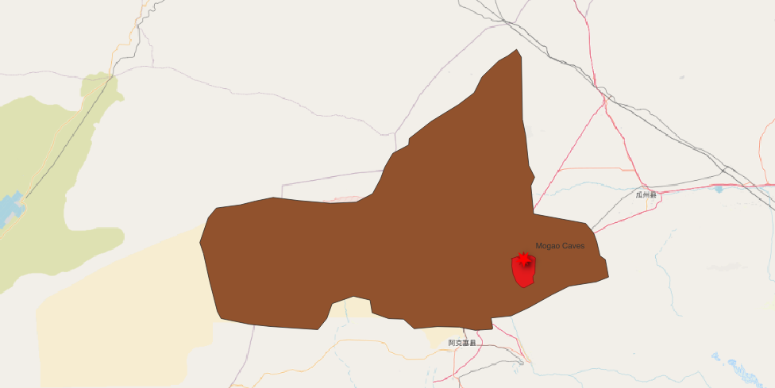
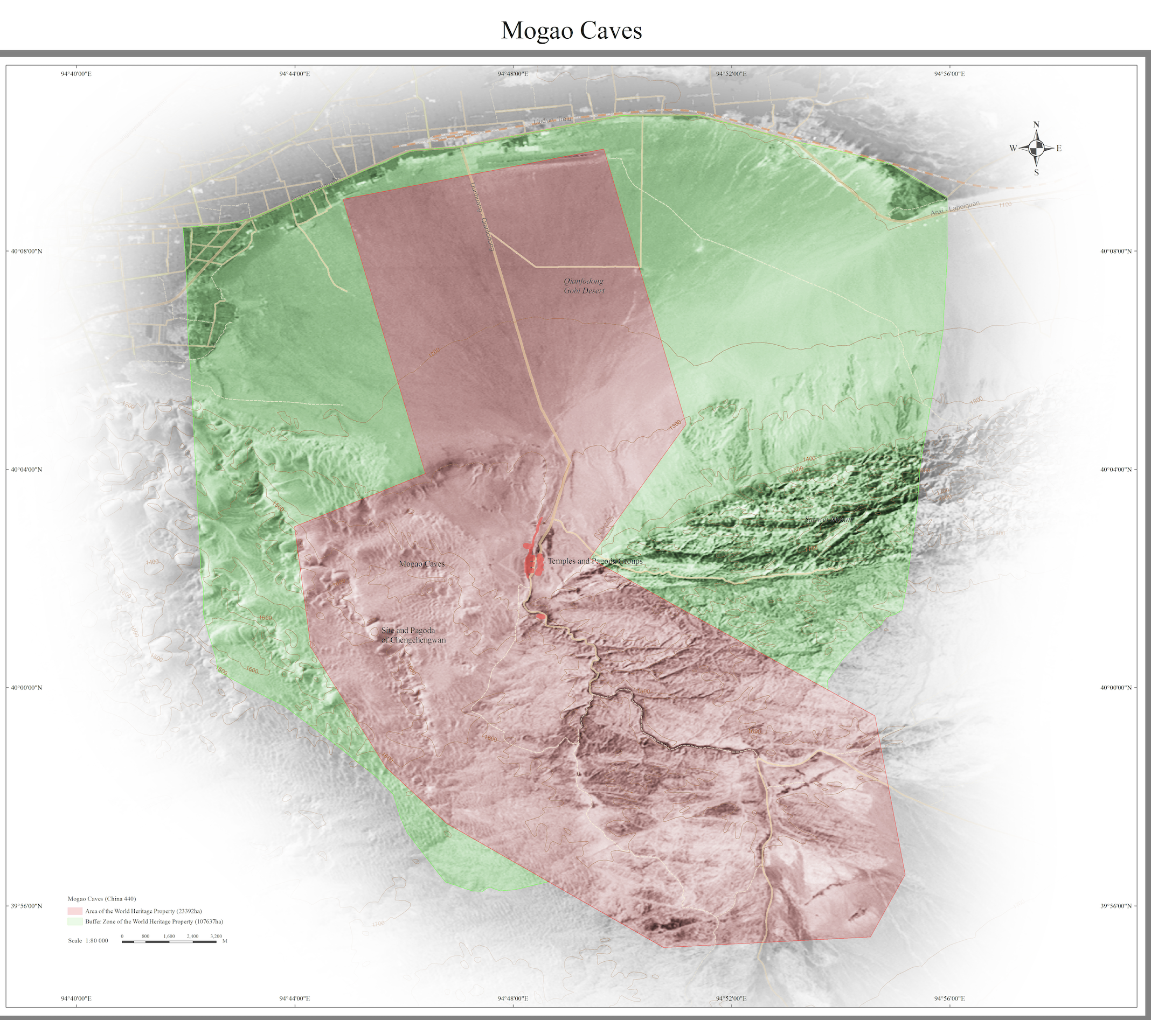
Example 6: Magao Caves
> Clear difference in the buffer and core can be seen
Notes:
The shape of the UNESCO PDF seems very summarrised in the polygon of the PUP data.

Slide 14
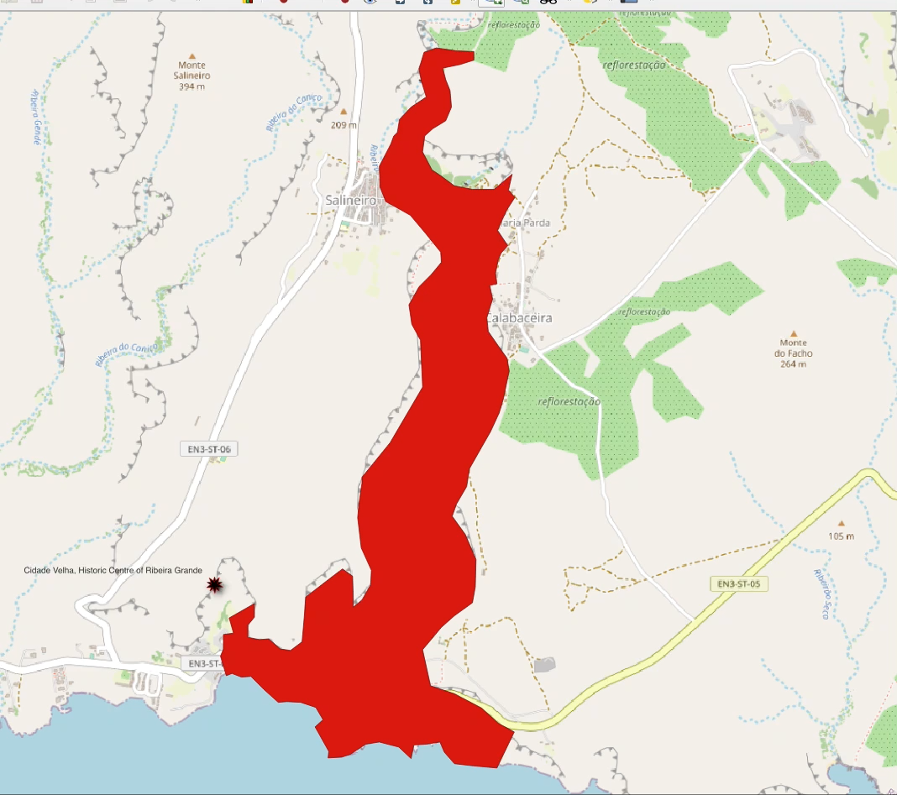
Example 7: Cidade velha, Historic Centre of Rubeira grande
Core zone boundaries in some location misses the boundary
Point data from WHList displaced
Notes:
Interesting representation almost accurate but no quiet. As observed the WHL is off, the Core zones is almost accurate with the OSM but shows some clear difference

Slide 15
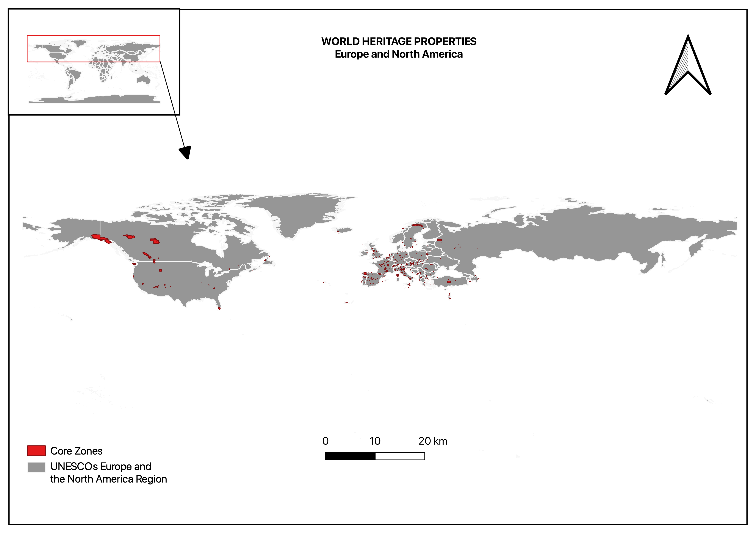
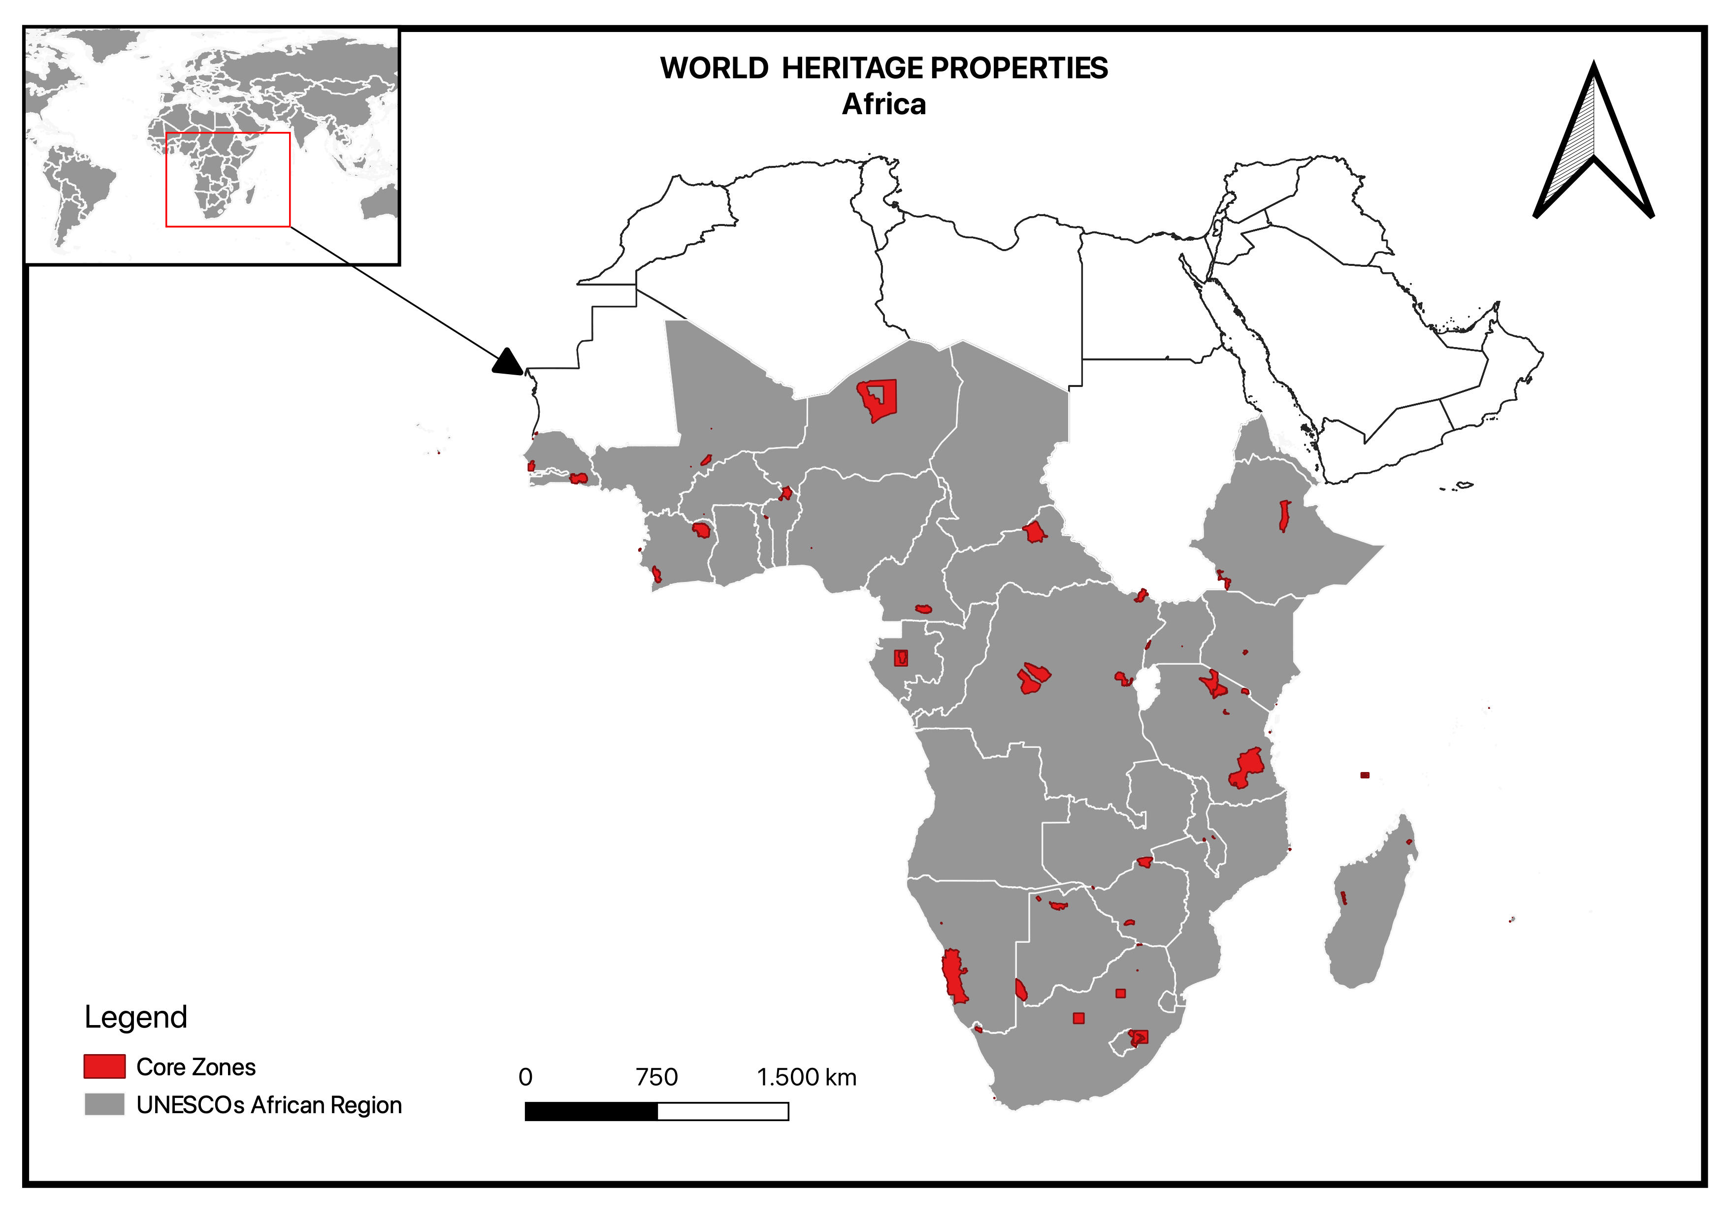
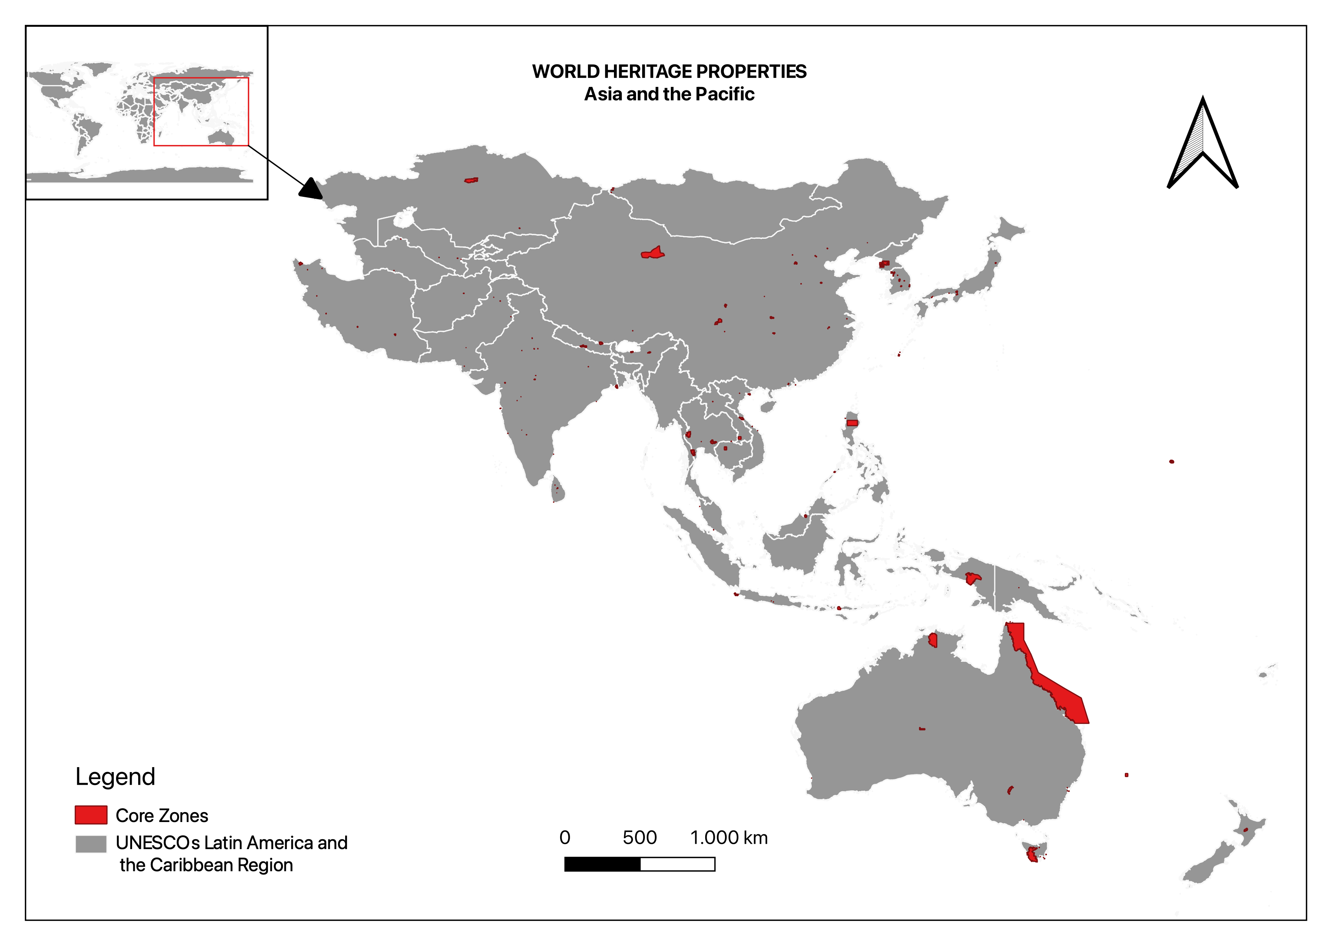
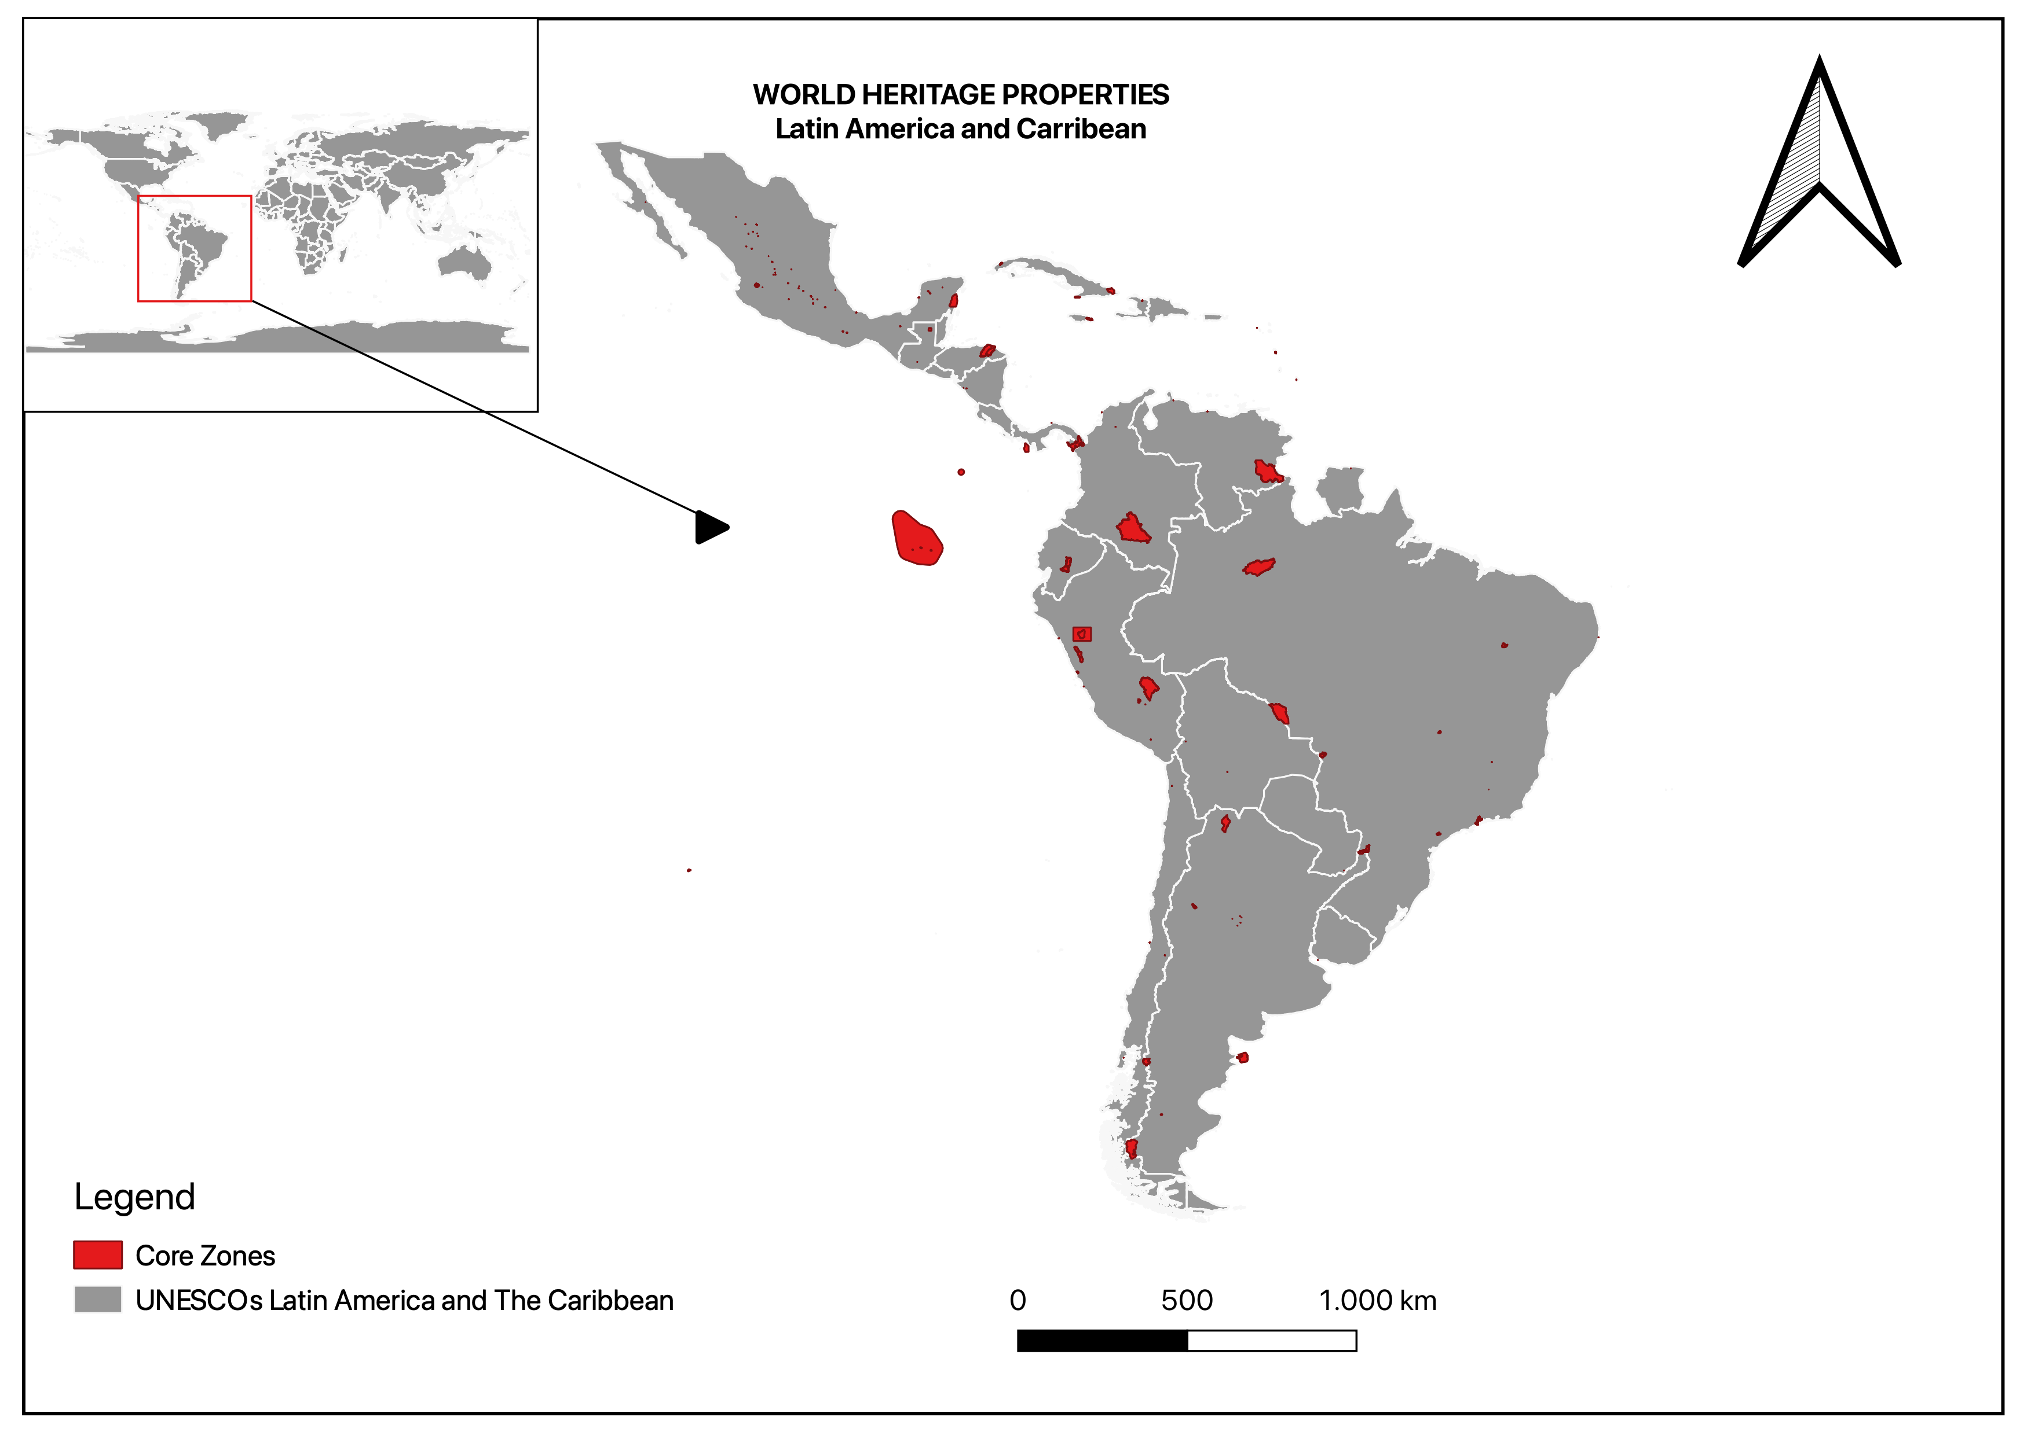
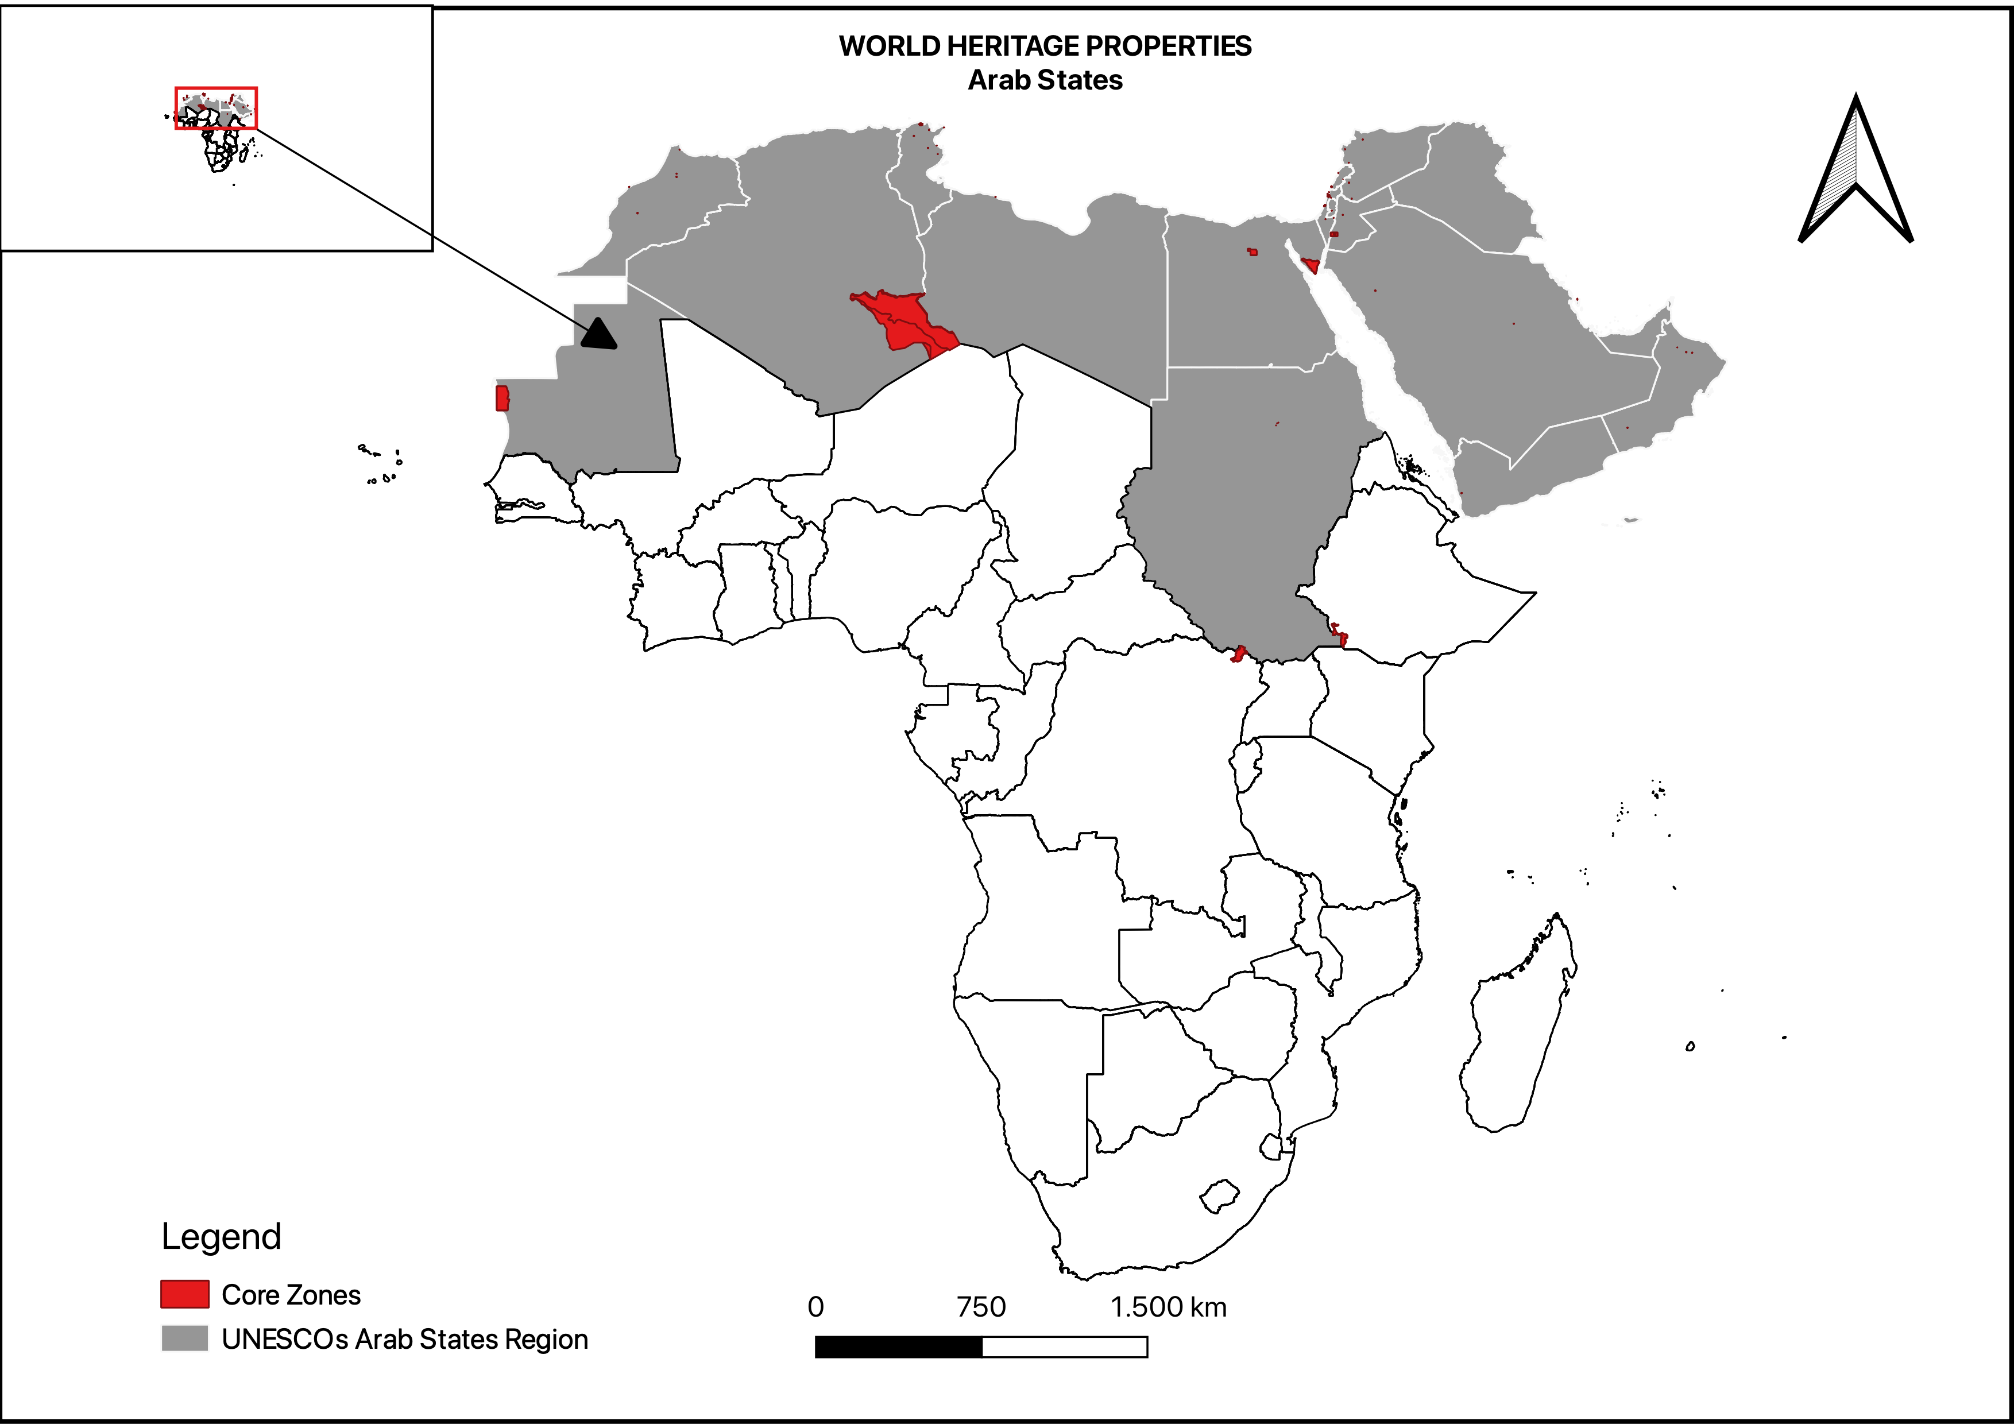
UNESCO Regions
Notes:
Core Zones organised in their UNESCO region
Not all properties as some of the properties do not exist on WDPA and PUP
Need to calculate how properties are missing ?

Slide 16
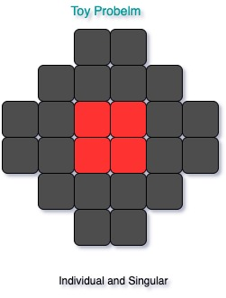
Supervisory Meetings Pirouz
Discussed the following:
Right softwares and communication channels such as: Slack, Github, Jupyter, Google Collab, Python, VS Studio, GIT on top of the softwares I already know.
Ideas arround topological data analysis for determining the varied natures of World Heritage cities and likely approaches.
Use of illustrations or toy problems to break down the problem.
key question being:
How to describe a particular spatial configuration of zones numerically?
Conducting literature review and working on a data flow
Notes:
This slide reflects the thing we have discussed with Pirouz focusing on his specialisation in the mathmatical analysis of geomentric shapes

Slide 17
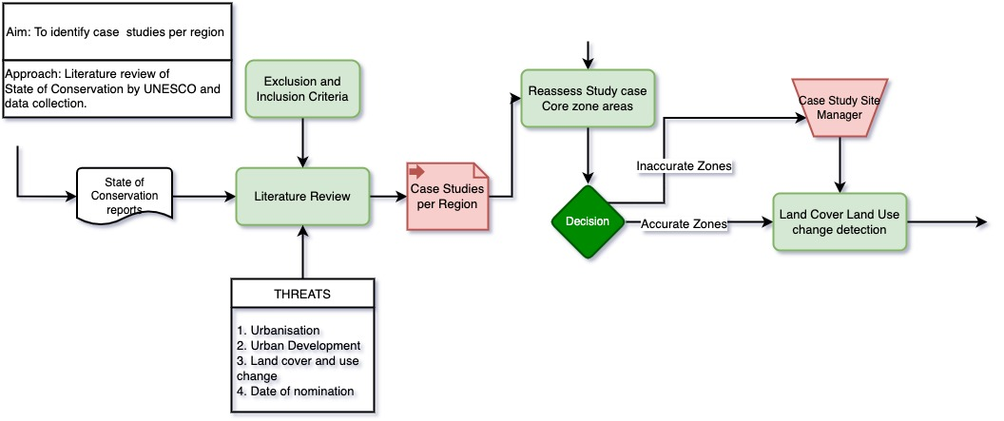
Workflow (2WEEKS)
Week 12/52 | Week 13/52 | Vacation | Vacation | Week 16/52 | Week 15/52
Notes:
Workflow in the next two week with a vacation in the 14th and 15th week
How ever the land cover and change detection is dependant on how soon the correct shape files can be obtained

Slide 18
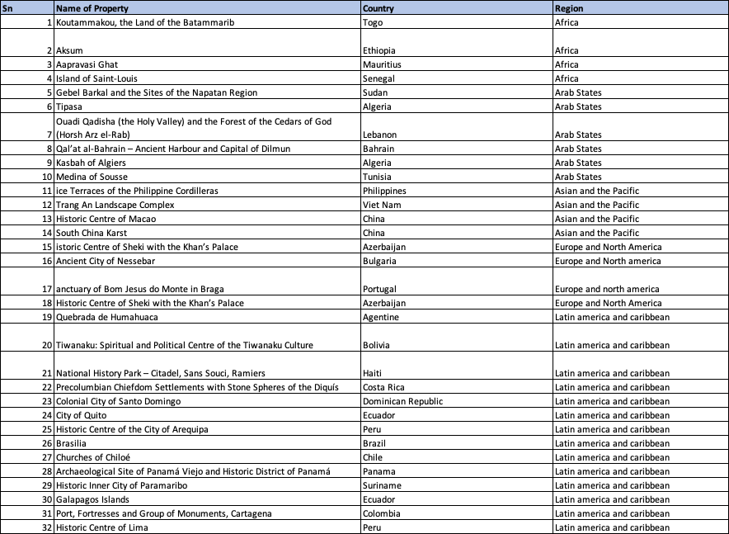
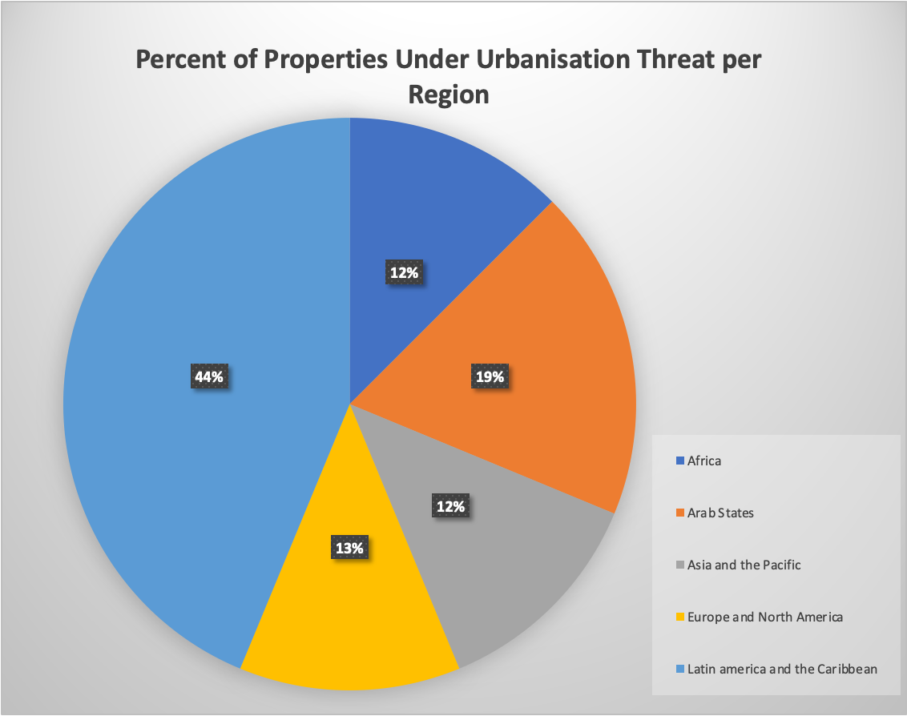
State of Conservation
Total: 32 properties

